Slide 1
ToDo-List App

Slide 2
Agenda
Git repo: https://github.com/MohamedMSayed07/depi-project/
List of tools that are used in the app
App Architecture
Docker
Terraform & AWS
Ansible
Jenkins & Slack

Slide 3
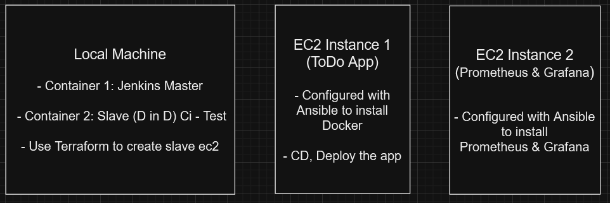
App Architecture

Slide 4
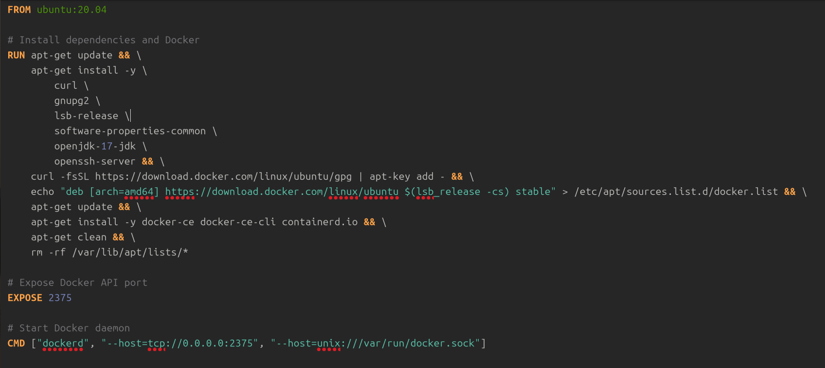
Docker: Customized DinD Dockerfile for the Jenkins-Slave :

Slide 5
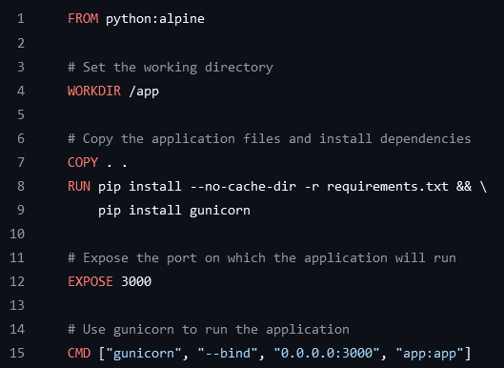
Docker: Docker File of the App
The app is containerized with Docker
It depends on a Docker Image that is built and push on Docker Hub
The used base image is “python:alpine”
The app will be accessed on port 3000
The entry point of the container for running the app is “gunicorn”

Slide 6
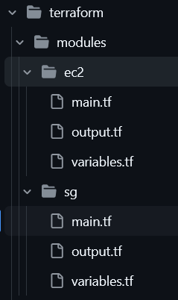
Terraform & AWS
Two modules were used in creating the infrastructure:
EC2: for defining the EC2
sg: for defining the security groups

Slide 7
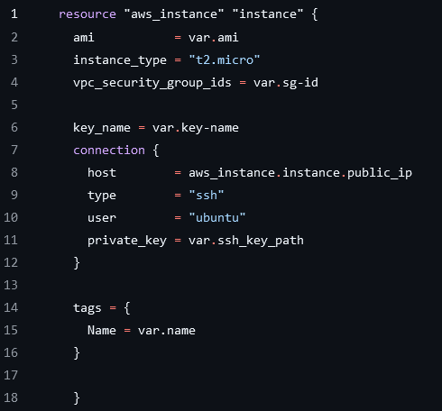
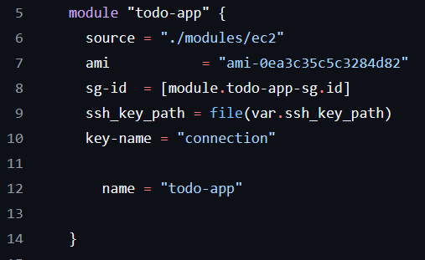
Terraform & AWS: EC2
The “ec2” module is used to create 2 instances on AWS for the following:
Instance 1: as a deployment environment for running the app
Instance 2: as a monitoring environment for Prometheus and Grafana

Slide 8
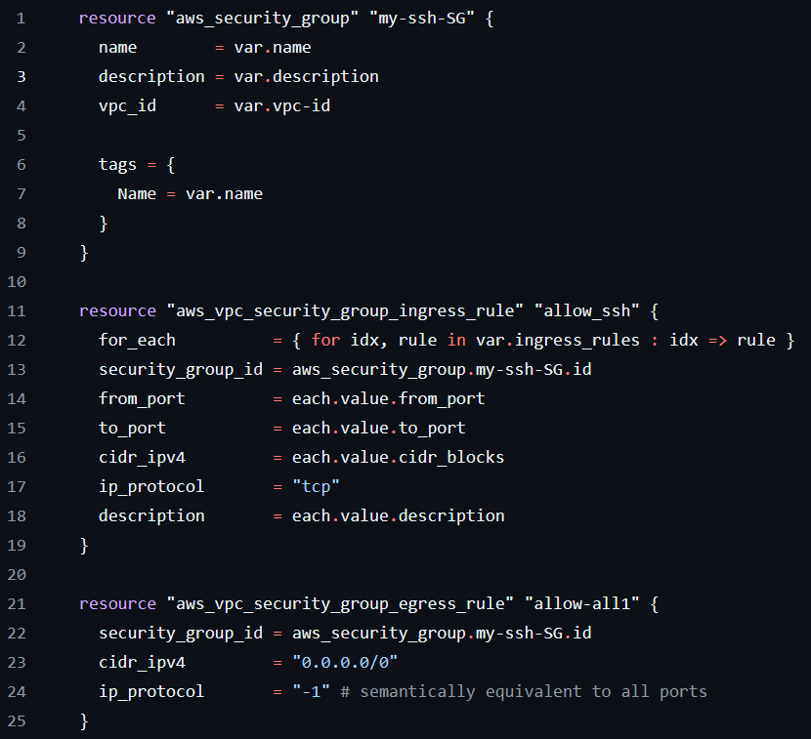
Terraform & AWS: sg
The “sg” module is used to create 2 security groups for the two EC2s on AWS for the following:
Security Group 1 “todo-app-sg”
Security Group 2 “prometheus-sg”

Slide 9
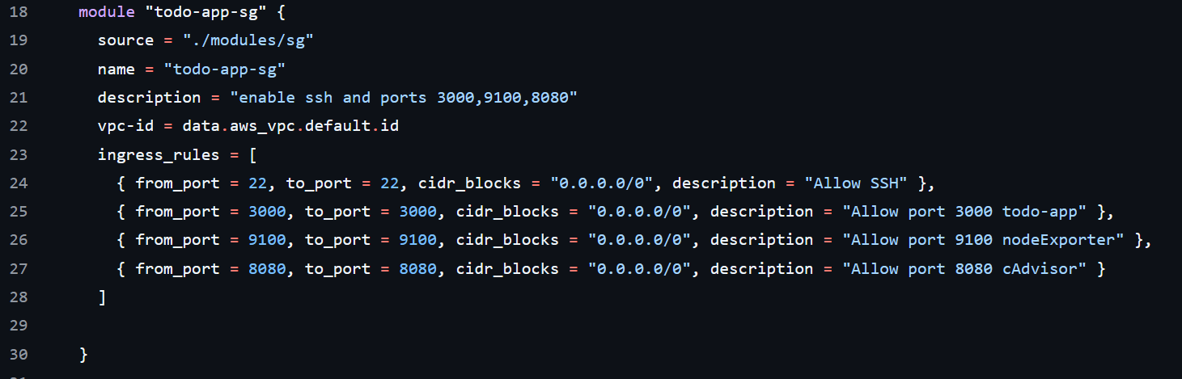
Terraform & AWS: sg
Security Group 1 “todo-app-sg” :

Slide 10
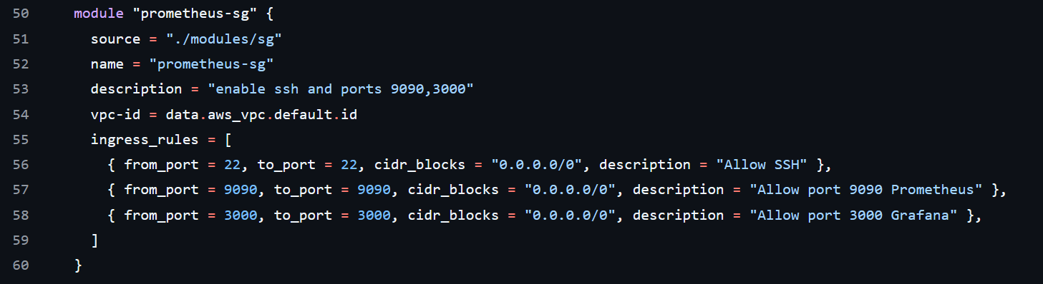
Terraform & AWS: sg
Security Group 2 “prometheus-sg” :

Slide 11
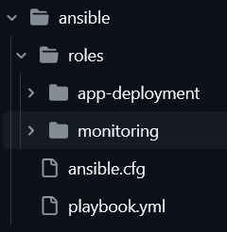
Ansible
Two modules were used in configuring the EC2 instances:
app-deployment: Includes the needed configurations for instance 1 (deploying the app)
monitoring: Includes the needed configurations for instance 2 (monitoring the app)

Slide 12
Ansible: “app-deployment” role
Includes the needed tasks for configuring EC2 instance 1 on which the app will be deployed. The tasks are grouped in 3 categories to enable the following:
Installing the needed tools for app-deployment
Installing node-Exporter
Installing cAdvisor

Slide 13
Ansible: “app-deployment” role, cont’d
Installing the needed tools for app-deployment will be done using the following tasks:
Task 1: - name: Update apt repository
Task 2: - name: Download Docker installation script
Task 3: - name: Run Docker installation script
Task 4: - name: Start and enable Docker service
Task 5: - name: Add the current user to the docker group

Slide 14
Ansible: “app-deployment” role, cont’d
Installing node-Exporter will be done using the following tasks:
Task 8: - name: Create a user for node exporter
Task 9: - name: Download Node Exporter using curl
Task 10: - name: Extract Node Exporter
Task 11: - name: Create Node Exporter systemd service file
Task 12: - name: Reload systemd daemon to register Node Exporter service
Task 13: - name: Enable and start Node Exporter service

Slide 15
Ansible: “app-deployment” role, cont’d
Installing cAdvisor will be done using the following tasks:
Task 6: - name: Install Python 3 and pip
Task 7: - name: Install Docker SDK for Python using apt
Task 14: - name: Pull cAdvisor image
Task 15: - name: Run cAdvisor container

Slide 16
Ansible: “monitoring” role
Includes the needed tasks for configuring the EC2 instance 2 on which the app will be monitored. The tasks are grouped in 2 categories to enable the following:
Installing Prometheus
Installing Grafana

Slide 17
Ansible: “monitoring” role, cont’d
Installing Prometheus will be done using the following tasks:
Task 1: - name: Update apt repository
Task 2: - name: Create Prometheus user with no shell access
Task 3: - name: Create Prometheus directories
Task 4: - name: Download Prometheus archive with curl
Task 5: - name: Extract Prometheus archive
Task 6: - name: Move Prometheus binaries
Task 7: - name: Set ownership for binaries

Slide 18
Ansible: “monitoring” role, cont’d
Installing Prometheus will be done using the following tasks:
Task 8: - name: Remove existing console_libraries directory if it exists
Task 9: - name: Remove existing consoles directory if it exists
Task 10: - name: Move Prometheus configuration and console libraries
Task 11: - name: Set ownership for Prometheus directories
Task 12: - name: Create Prometheus systemd service
Task 13: - name: Reload systemd and start Prometheus service

Slide 19
Jenkins & Slack
Jenkins is the used CI/CD tool for automating tasks and deploying the app.
The pipeline is triggered using the github webhook according to the changes on the github repository
The github repository includes the Jenkins file that includes the stages of the CI/CD pipeline.
After the pipeline is finished, a notification message is sent to a Slack Channel to show whether the pipeline succeeded or failed.

Slide 20
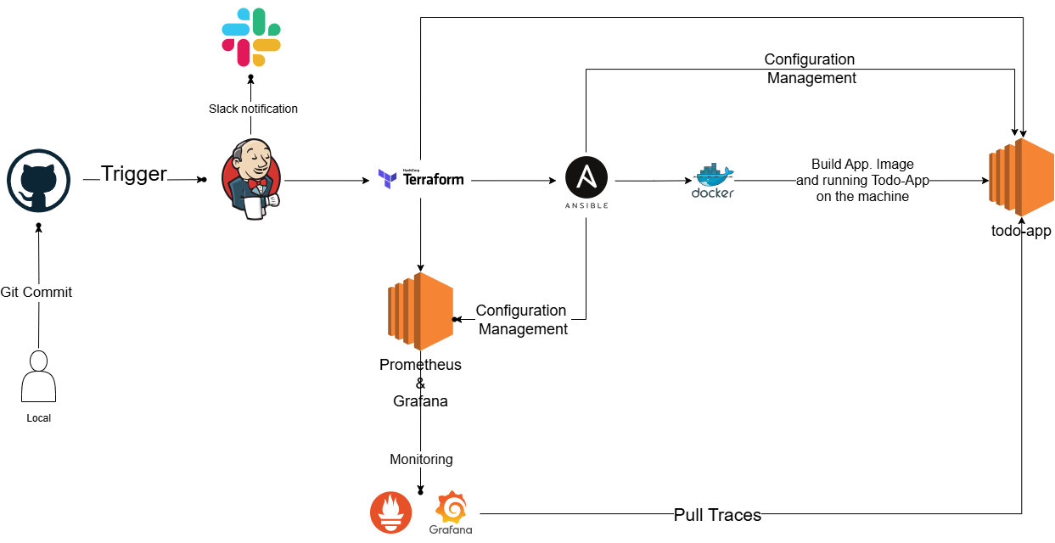
Jenkins & Slack

Slide 21
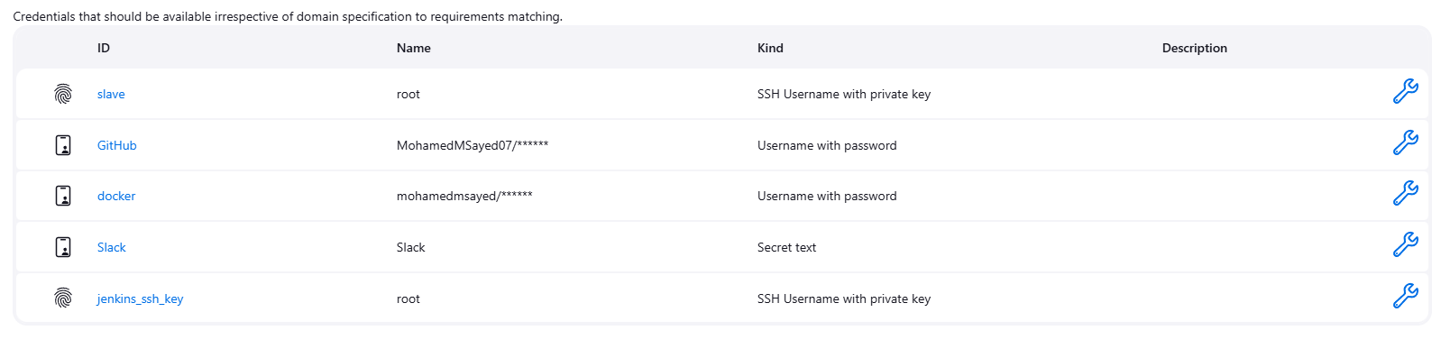
Jenkins & Slack
Credentials

Slide 22
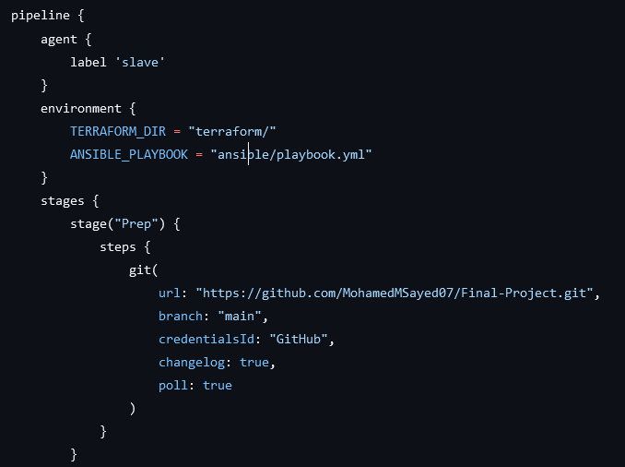
Jenkins & Slack, cont’d
Pipeline stages are as follows:
Stage 1 “Prep”:
Clones the github repo.

Slide 23
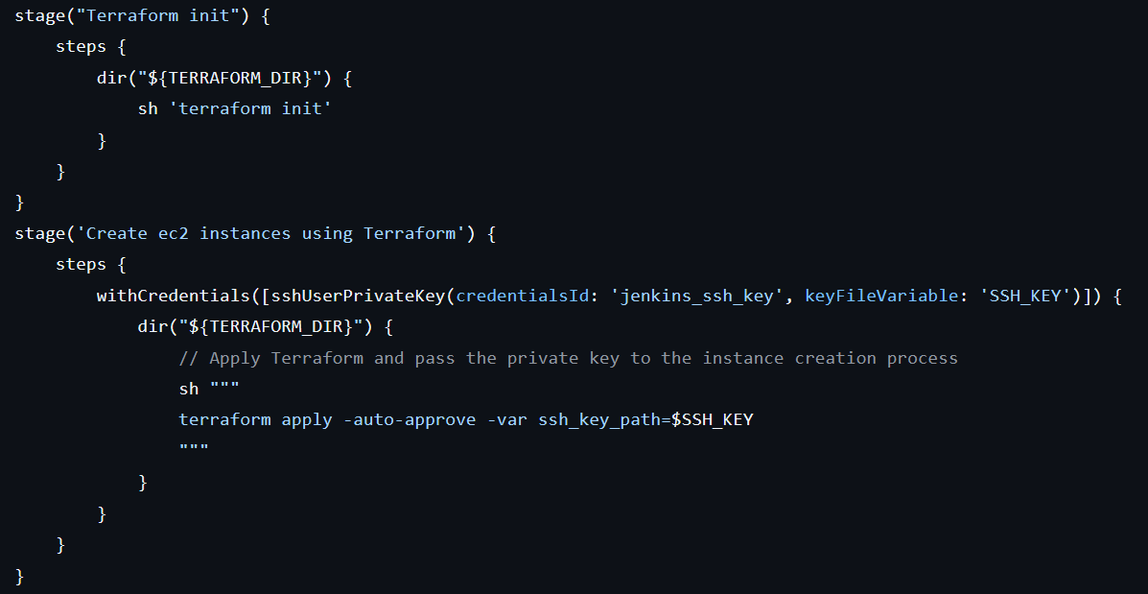
Jenkins & Slack, cont’d
Stage 2
“Terraform init”
Stage 3
“Create ec2 instances using Terraform”:

Slide 24
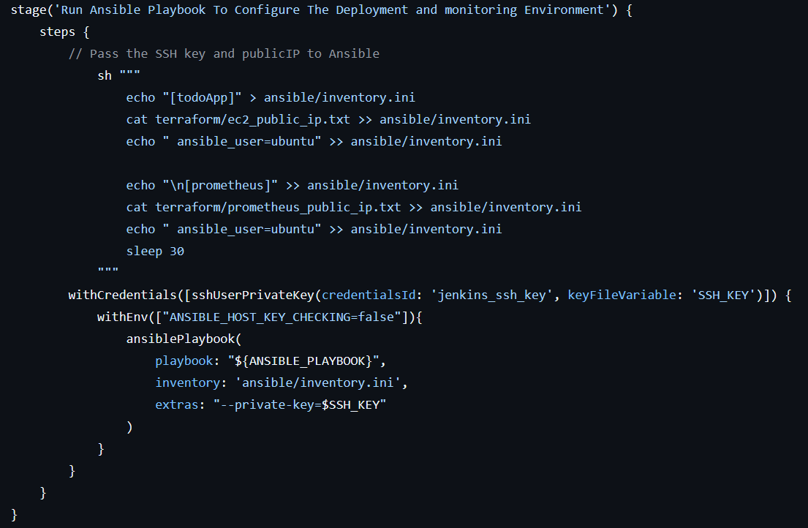
Jenkins & Slack, cont’d
Stage 4
“Run Ansible Playbook To Configure The Deployment and monitoring Environment ”

Slide 25
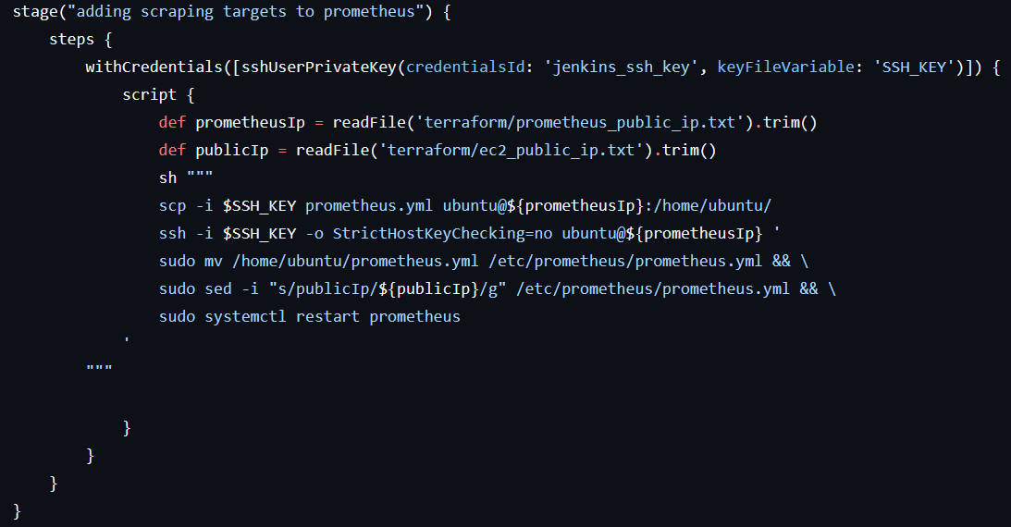
Jenkins & Slack, cont’d
Stage 5
“ Adding scraping targets to prometheus “

Slide 26
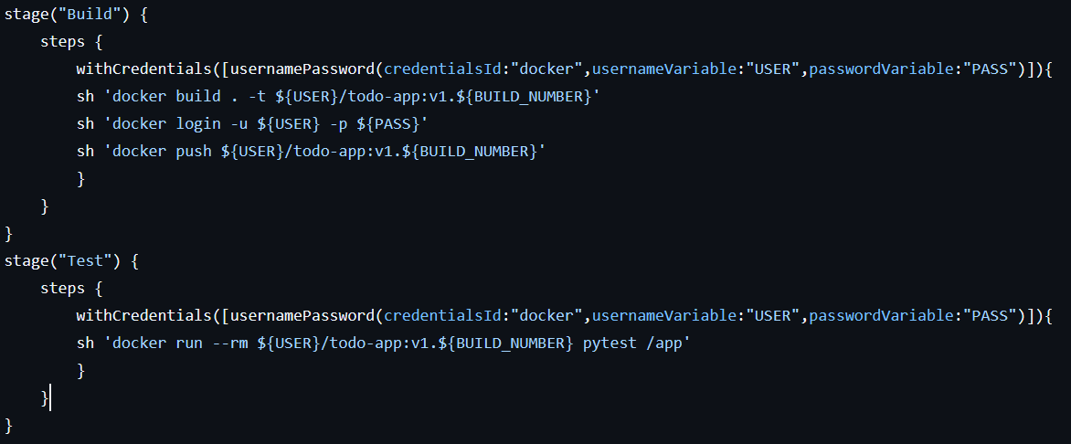
Jenkins & Slack, cont’d
Stage 6 “Build” & Stage 7 “Test”

Slide 27
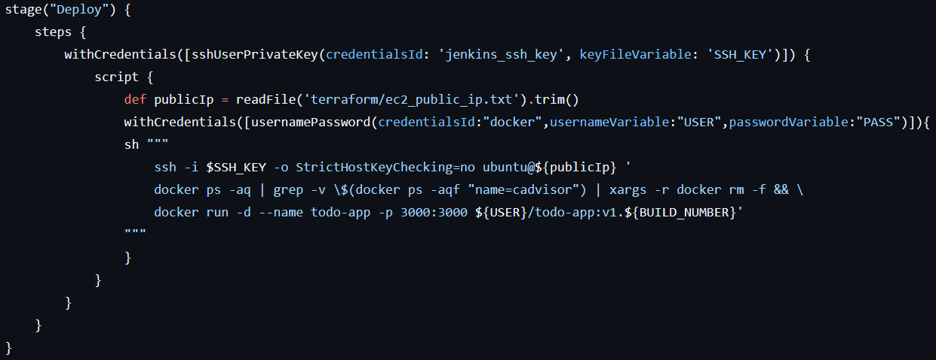
Jenkins & Slack, cont’d
Stage 8 “Deploy”

Slide 28
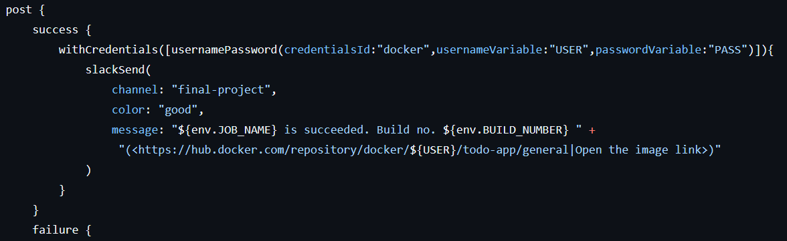
Jenkins & Slack, cont’d
Slack Integration

Slide 29
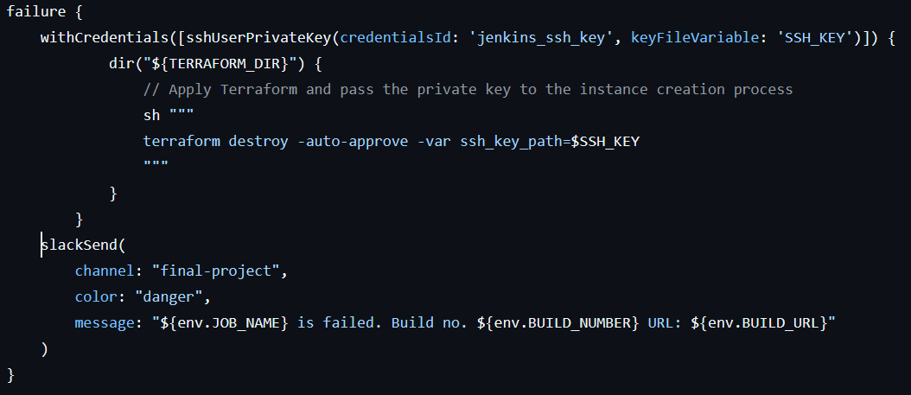
Jenkins & Slack, cont’d
Slack Integration, cont’d

Slide 30
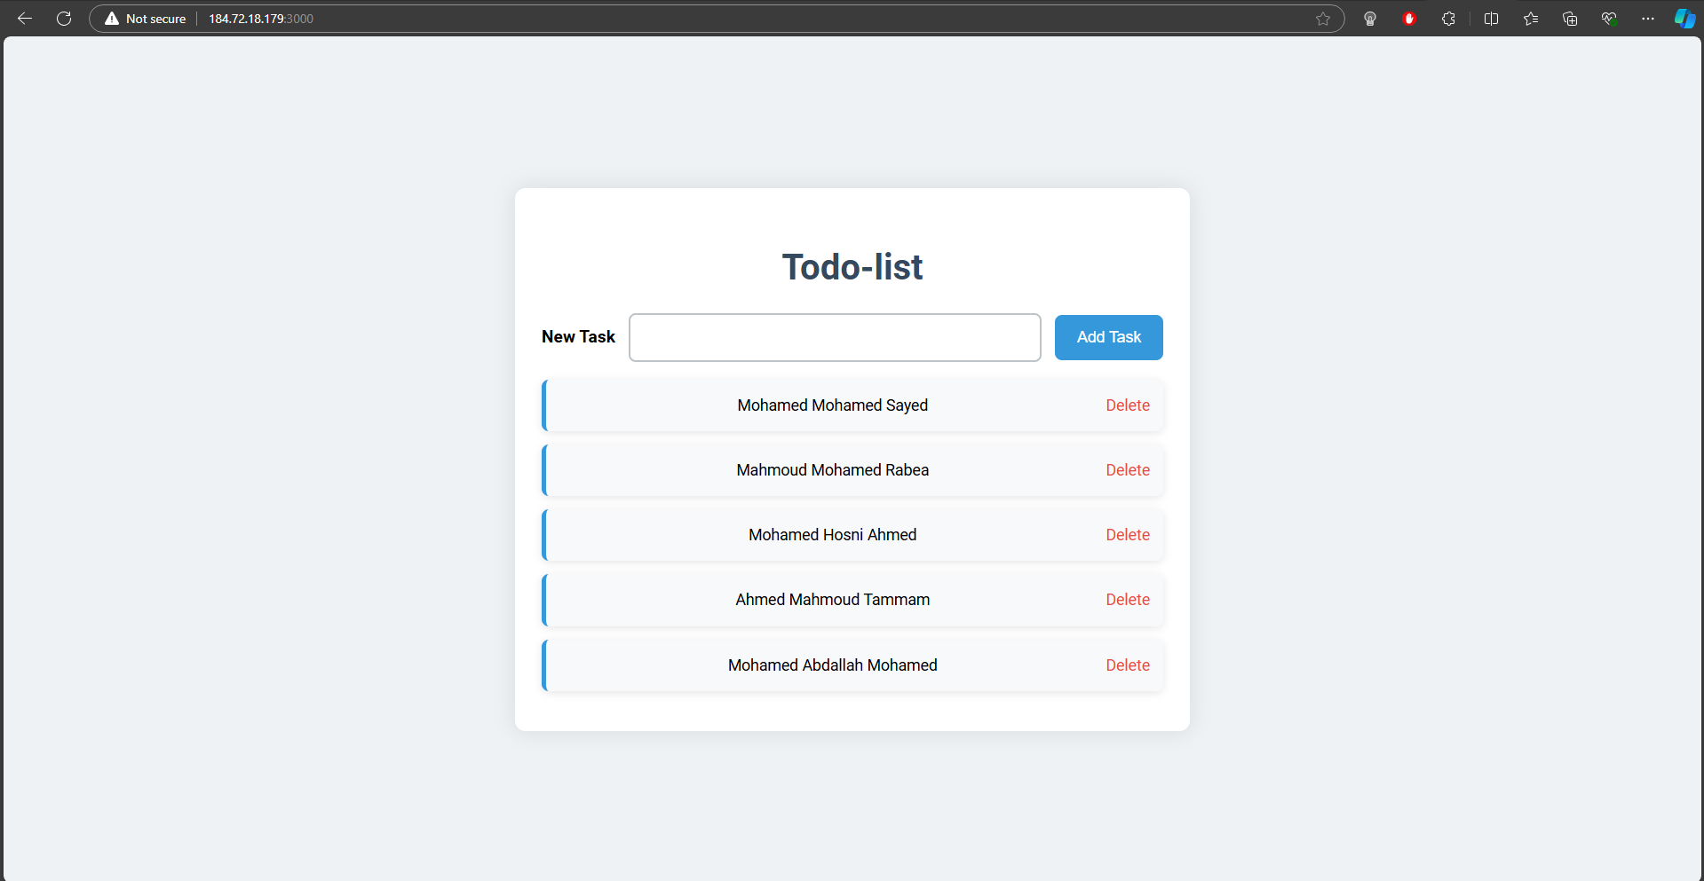
Results

Slide 31
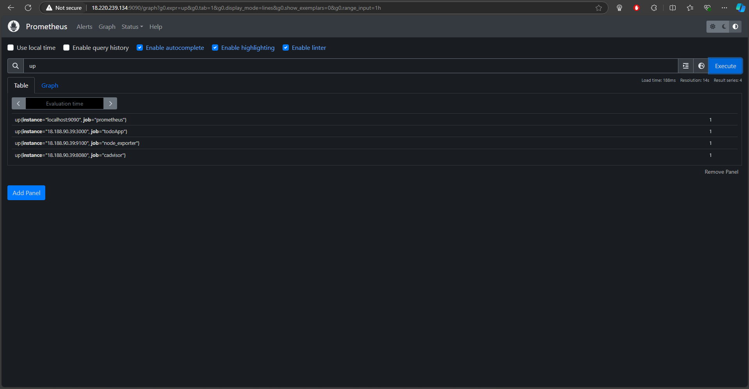
Results

Slide 32
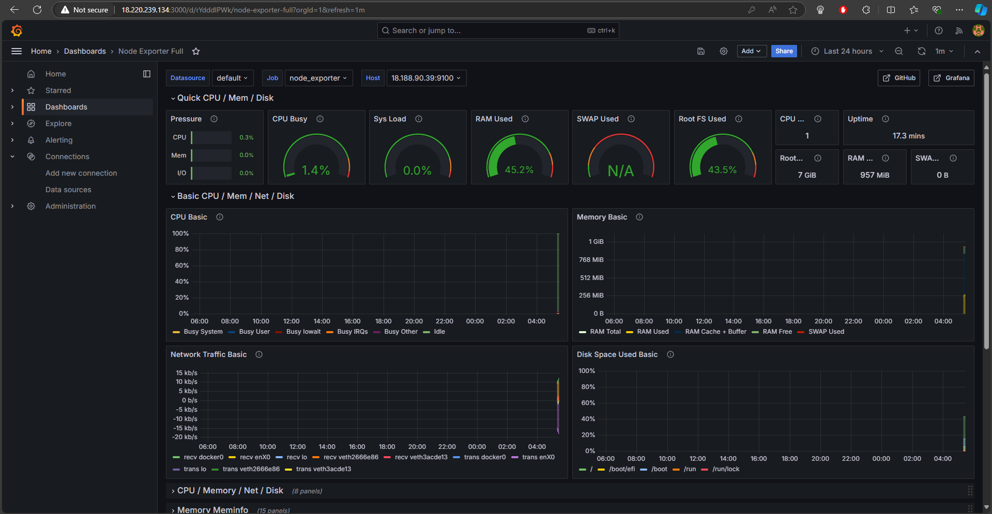
Results

Slide 33
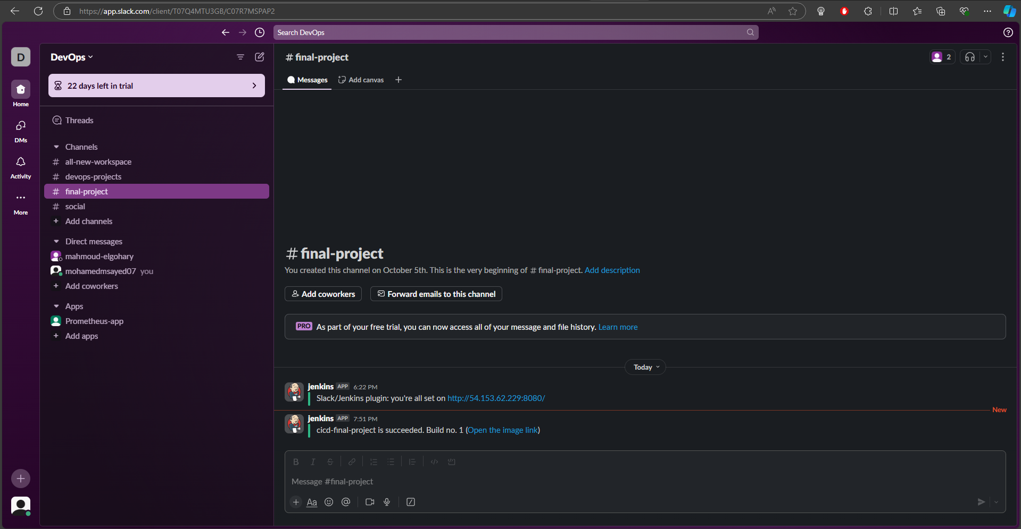
Results

Slide 34
Thank You

